Slide 1
WORKSHOP NAZIONALE DI RICERCA – AZIONE CLIL per Docenti delle Discipline d’Indirizzo dei Licei Economico Sociali “SCIENZE UMANE” e “DIRITTO ED ECONOMIA POLITICA” - II FASE
ROMA 6-7 OTTOBRE 2016

Slide 2
PLANNING CLIL ACTIVITY TITLE: Human Rights and Nobel Peace Prize Prof.ssa Anna Maria Imbarrato
Liceo “Forteguerri” - Pistoia -
Indirizzo Economico Sociale (LES)
Classe:IV H
A.S.:2015/16
Subject Area:Human Sciences
Language:English
Timing:5 units

Slide 3
START UP
Le motivazioni per cui fare CLIL sono ben espresse nelle prime pagine del testo pubblicato da University of Cambridge dal titoloTeaching Knowledge Test
“There are many advantages to the CLIL approach: it develops confident learners and enhances academic cognitive processes and communication skills. CLIL encourages intercultural understanding and community values. In addition, research shows that learners become more sensitive to vocabulary and ideas presented in their first language as well as in the target language and they gain more extensive and varied vocabulary.” (p.2)

Slide 4
PLANNING ACTIVITY
COOPERATION AND REFLECTION
educational aims
learning aims
pre - requisites
CLIL aims

Slide 5
Educational aims
COMPETENZE DI CITTADINANZA EUROPEA :
Imparare ad imparare
Acquisire e interpretare l’informazione
Individuare collegamenti e relazioni
Risolvere problemi
Progettare
Agire in modo autonomo e responsabile
Comunicare
Collaborare e partecipare

Slide 6
2. Learning aims
OSA - Indicazioni Nazionali Nuovi Licei - Disciplina Scienze Umane
comprendere le dinamiche proprie della realtà sociale, con particolare attenzione al mondo del lavoro, ai servizi alla persona, ai fenomeni interculturali e ai contesti dellaconvivenza e della costruzione della cittadinanza;
comprendere le trasformazioni socio-politiche ed economiche indotte dal fenomeno della globalizzazione, le tematiche relative alla gestione dellamulticulturalità e il significato socio-politico ed economico del cosiddetto “terzo settore”;
sviluppare una adeguata consapevolezza culturale rispetto alle dinamiche psicosociali;
padroneggiare i principi, i metodi e le tecniche di ricerca in campo economico-sociale.

Slide 7
3. Pre - requisites- - - -
Content
basic meanings that culture has to mankind;
cultural differences and reasons that caused them also in their connection with the geographical space where they took place;
the complex concept of humanity and culture.
Language
B1/B2
Linking to Previous Knowledge and Predicting (Scaffolding)
Italian/English Glossary
BICS

Slide 9
4. CLIL aims- - - -
introduce learners to new ideas and concepts in curriculum subjects
improve learners’ performance in both curriculum subjects and the target language
encourage stronger links with the citizenship curriculum
increase learners’ confidence in the target language

Slide 10
Learning Aims / Subject Content
Learning Aims / Language Content
Cognitive Skills
Communication Skills
SUBJECTS LITERACY

Slide 11
1.Learning Aims / Subject Content
to know the cultural assumptions and nature of human rights
to know the Universal Declaration of Human Rights
to know the Declaration of the Rights of the Child
to know the basic aspects of the historical - social contexts in which they operate some of the most famous winners of the Nobel Prizes for Peace

Slide 12
2.Learning Aims / Language Content
to strengthen oral communicative skills in L2
(from BICS to CALP)
to identify the cultural diversity within our society and our country
to be open to dialogue and exchange among cultures

Slide 14
3.Cognitive Skills
fromLOTS - Lower order thinking skills(to remember information, to order information, to define objects, to check understanding, to review learning)
toHOTS - Higher order thinking skills(to develop reasoning skills, to develop inquiry and discussion, to develop creative thinking, to evaluate the work of oneself and others; to hypothesise about what could happen)

Slide 15
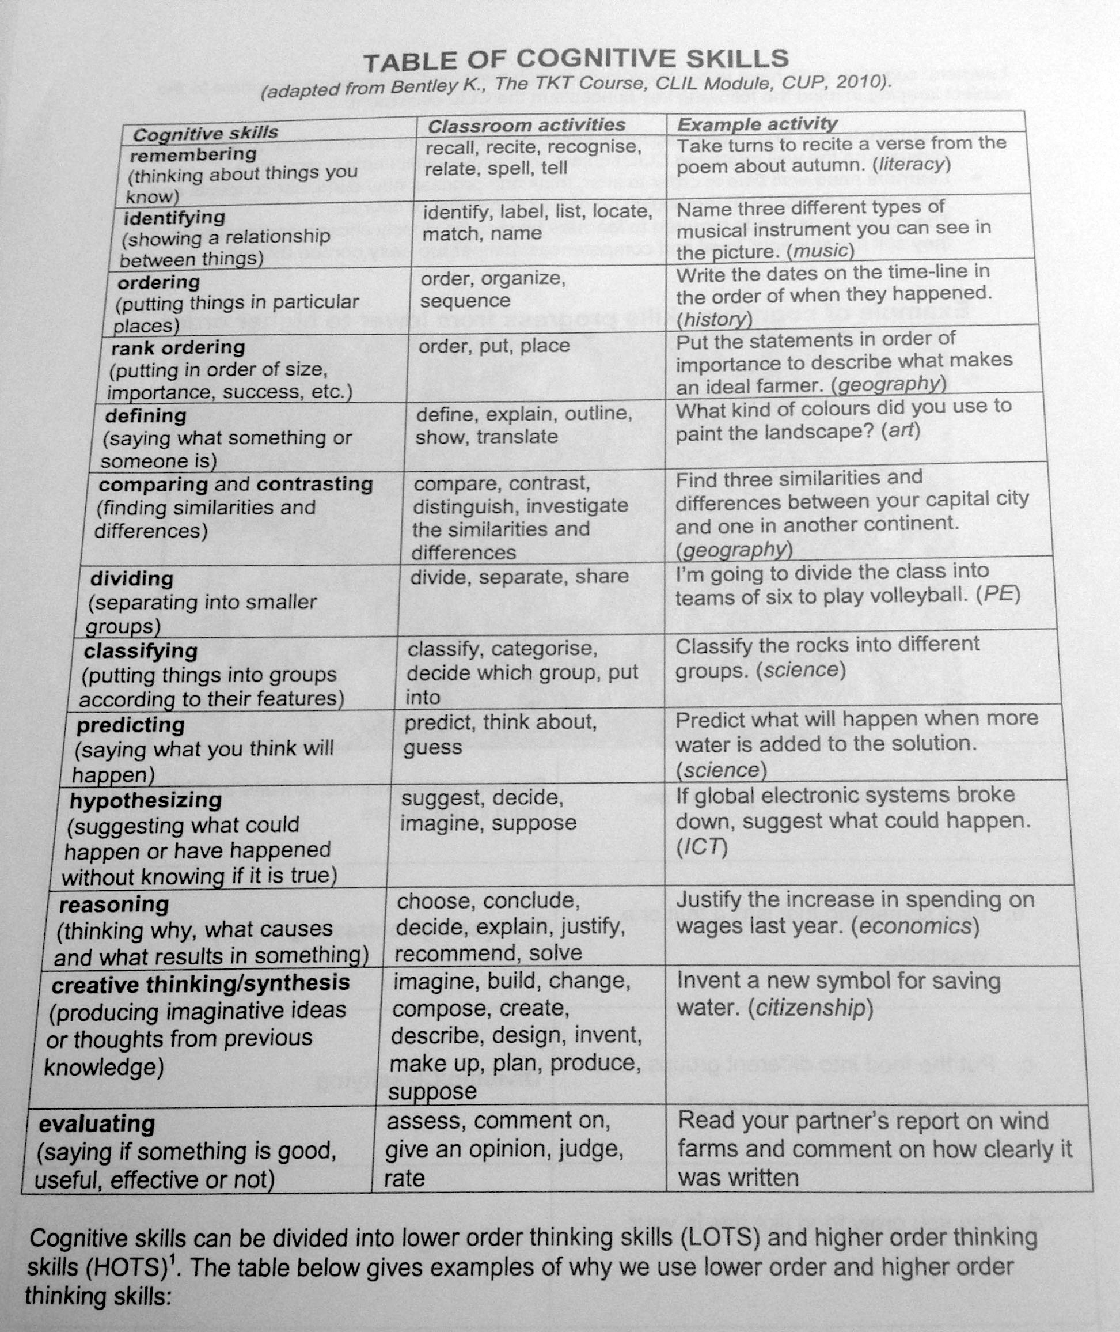

Slide 16
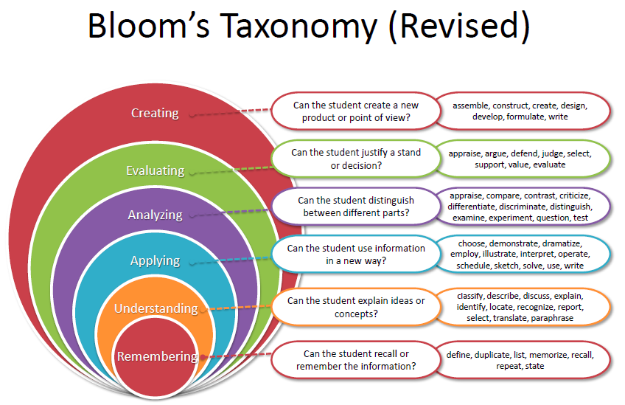

Slide 17
4a.Communication Skills
agreeing or disagreeing;
asking questions;
clarifying what has been said;
comparing and contrasting;
demonstrating;
describing cause and effect;
describing a process;
explaining a point of view;
evaluating work (self and others);
expressing ideas;
generalising;
giving examples;
giving information;
hypothesising;
instructing;
interpreting data;
persuading;
predicting and justifying predictions;
presenting solutions;
presenting work;
suggesting

Slide 18
4b.Communication Skills
Language needed to deliver subject content at word, sentence and text levels.
Genre texts: advertisements; argument; article; autobiography; biography; description; discussion; essays; explanation; instruction; letters; narrative; notices; persuasion; poem; process; proposal; recount; report; review; song.

Slide 19
CONTEXT and CULTURE (class)
INTERACTION (Team Teaching with the Law and Economics Teacher)
LEARNERS’ NEEDS
“All the teaching procedures are determined by the subject. Language needs are taken into account secondarily, when one needs to explain the terms or capture the typical structures of the language of the subject. “
Quartapelle (a cura di)Assessment and evaluation in CLIL

Slide 20
Context & Culture - Interaction
Laclasseè composta da 20 allievi ed allieve, 1 diorigine e culturamarocchina e 1 diorigine e culturaalbanese. Dal punto di vista del dialogo educativo la classe è senza dubbio partecipe, motivata ed interessata anche a lavorare su attivitàinterdisciplinari(Diritto - Economia politica) anche in ambito CLIL, che hanno consentito di potenziare l’area di indirizzo fin dal biennio. Dal punto di vista del profitto sono presenti tre fasce di livello con punte di eccellenza per risultati e studio).

Slide 21
2. Interaction
L’attività CLIL che qui viene presentata presenta alcuni elementi di forza per quello che concerne ilcontestoin cui si è svolta, quali: il sostegno e la valorizzazione dal parte del D.S.; la piena disponibilità all’utilizzo del laboratorio linguistico, dotato di PC e LIM, con connessione Internet che ha consentito di usufruire appieno delle opportunità offerte in ambito multimodale;la forte sintonia professionale tra le due docenti di indirizzo che ha permesso di raccordare le attività proposte, frutto anche del lavoro sinergico tra i due Dipartimenti disciplinari. Più problematico il lavoro con l’insegnante di L2, visto che precedenti esperienze CLIL, non sono state accolte di buon occhio né dal Dipartimento di Lingue né dalla docente.

Slide 22
interactive methodology
peer to peer
cooperative learning
METHODOLOGY

Slide 24
web sites
digital tools
ways to integrate ICT into the curriculum
MULTIMODALITY
Learning StyleVARK
(Visual,Auditory,Reading and Writing,Kinesthetic)

Slide 25
Web sites
Università
Istituzioni Governative e Non
ONLUS
giornali, riviste, televisioni
senza dimenticare quelli che consentono di costruire e realizzare concretamente prodotti multimediali attraverso l’uso di opportuni ….

Slide 26
… Digital tools
multimedia
visual / graphic organisers such as timelines, flow charts, maps, graphs, tables, charts, diagrams
key concept maps (to show relationships between ideas) such as cause-effect, classification, hierarchy, process, time sequence

Slide 27
3. Integrate ICT
PowerPoint presentations
word processing
web searches
adding graphics
using a database to sort, question and present information
using, interpreting and manipulating digital images
use ‘draw’ or ‘paint’ software

Slide 28
“There are three main concepts associated with assessment
a) assessment OF learning;
b) assessment FOR learning;
c) assessment AS learning. “
Quartapelle (a cura di)Assessment and evaluation in CLIL
ASSESSMENT and
EVALUATION

Slide 29
Assessment...
of is“summative” assessment
for is “formative” assessment
as increases the awareness about the learning processes

Slide 30
Una delle difficoltà cui il docente spesso si trova ad andare incontro durante lo svolgimento di un'attività CLIL è lavalutazione delle conoscenze e delle competenze, poiché non vi è ancora un insieme consolidato di pratiche per una valutazione combinata di contenuto e lingua.
Sembra indispensabile che, in ogni caso, data la peculiarità dell'attività CLIL, qualunque pratica di valutazione non possa prescindere da unauthentic assessment, ovvero una valutazione sulle effettive competenze acquisite, piuttosto che il semplice controllo delle conoscenze tramite il consueto paradigma domanda - risposta.

Slide 31
Authentic assessment
“As regards measurement there is a substantial difference between the activities that have the characteristics of anexerciseand those which have the characteristics of atask.
In thefirstcase, represented by activities such as cloze, matching, multiple choice, or answers to closed questions, the answer generally can be just either right or wrong, while in thesecondcase, where the creativity of the student is involved, his/her ability regarding personal revision, the response is not entirely predictable to a large degree.”
Franca Quartapelle in “Assessment and Evaluation in CLIL” ©AECLIL- EACEA 2012 -

Slide 32
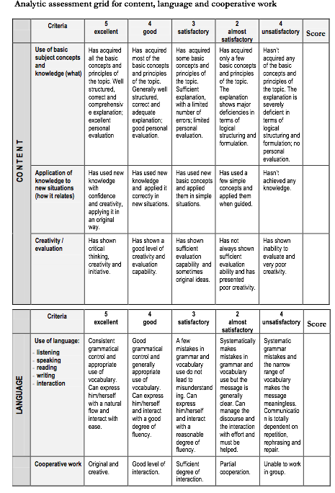

Slide 33
The Human Rights
The Universal Declaration of Human Right and Declaration of the Rights of the Child
History of The Nobel Peace Prize
Social contest
Final Assessment
SYLLABUS

Slide 34
ACTIVITY 1. The Human Rights.
a) Warm up:build up our glossary;
in pairs:research on web sites, I suggest http://ed.ted.com/lessons/what-are-the-universal-human-rights-benedetta-berti
underline and highlight the key-words;
in plenary:each group reads its own paper and writes on the whiteboard their key-words. The words will be divided in two groups:
useful common expression (e.g. idiomatic expressions) in red
specific topic word (e.g. right and social- psychological tecnichal words)blue
b) Main activity:
in pairs:1) try to classify those, in their opinion, that are inalienable
2) justify their choice
c) Conclusions:find on the web countries where these rights are denied or not recognized.

Slide 35
ACTIVITY 5. Final assessment
Power point presentations:
Rigoberta Menchu
Malala
Betty Williams and Mairead Corrigan
Mother Teresa

Slide 36
thank you for your attention

