Slide 1
Workshop nazionale clil4les
Learning unit: PRESIDENT IMPEACHMENT:
A comparative study in the constitutions of European countries
Liceo Scienze Umane
Liceo Economico –sociale
«Fabrizio de Andrè» - Brescia
Prof.ssa Paola Cavagna
Prof.ssa Paola Graffeo
Roma 6-7 ottobre 2016

Slide 2
teaching unit “The president impeachment”
PLENARY: what is president IMPEACHMENT?
FINAL ASSESSMENT
Lesson 1
Lesson 2
Lesson 3 -4
EVALUATION
WARMIN – UP
Pairwork in ICT lab: Surfing the European website for the Q/A activity
GROUP WORK: The comparative study of European constitutionsP

Slide 3
teaching unit PLAN AND CLIL 4CS
Subject Area: Law and Economics
Topic Focus: Constitution articles about President impeachment
Level/year: B2 / 5th Year LES
Time: 9 hours max
Content:
Teaching aims
To analyse deeply some European constitutions
Learning outcomes
To augment vocabulary related to Constitution text
To understand the principles of the warranty system of the politicians in some European countries
To think critically and discuss the President’s role in a State
To identify the countries which belong to the EU and to make students more aware of them

Slide 4
teaching unit PLAN AND CLIL 4CS
2. Cognition:
Cognitve skills
Comparing and contrasting the articles about Head of State and impeachment
Classifying proceedings of impeachment
Suggesting the reasons of the differences about impeachment
Carrying out a more in-depth analysis of the constitutional texts
3. Communication:
Language Skills
Bics (basic interpersonal communicative skill)
Development of socio-communicative functions at level B2
Calp (Cognitive Academic Language Proficency)
Participation in learning and using the language through speaking, listening, reading and writing activities in legal language

Slide 5
teaching unit PLAN AND CLIL 4CS
4. Culture:
To make students aware of the need to live an open and multicultural society
To raise awareness of European diversity
To promote students’ interest in the events that take place in the other countries and how they can be affected by them.
Teaching strategy and resources
Thinking aloud, oral scaffolding-questioning, teacher’s speech, groups work
Slides, videos, specific internet sites, Constitutions, Ict
Assessment
Questions, individual activities, groupworks, homework, dictionary

Slide 6
Agenda
LESSON 1
LESSON 2
LESSON 3 and 4
Warming up Q/A
Building a word cloud together
Listening activity: video about the impeachment of the american President
Plenary: the teacher explains what is impeachment
Homework: building up the personal dictionary
Write the answer in the chart looking for information in the official website
Group work: comparison between different impeachment procedures in some European constitutions
Presentation to the class of the group work
TEST, ASSESSMENT and EVALUATION

Slide 7
LESSON 1: WARMING UP LESSON
step 1: WARMING UP QUESTIONS/ANSWERS
The students surf the European website, answer to the following questions and write them in the chart
How many Presidents had Italy got in its history till now?
How many Italian Presidents were impeached?
What office/institution can impeach a President?
Do you remember the Italian proceeding impeachment?
How many Presidents are there in EU?
How many constitutional monarchies /parlamentary monarchies are there in EU?
How many presidential/semi-presidential/parliamentary republics are there in EU?
In what country are there?

Slide 8
step 2: VISIT THE E.U. WEBSITE, LEARN EUROPE
http://europa.eu/teachers-corner/home_en

Slide 9
step 3: FILL THE TABLE
QUESTION | ANSWER
1. ?
2. ?
3. ?
4. ?
5. ?
6. ?
7. ?

Slide 10
step 4: HOMEWORK, DICTIONARY TO SEND TO THE TEACHER ON EDMODO
1. Students write the unknown keywords and look for their meanings in an on-line dictionary:
DICTIONARY’S SAMPLE
WORD | MEANING
constitution
http://dictionary.cambridge.org/dictionary/english/arson
2. Then they fill their dictionary as shown in the sample
3. They can send their dictionary to the teacher on EDMODO
4. They can compare them during the lesson and complete them mutually ordering the words alphabetically

Slide 11
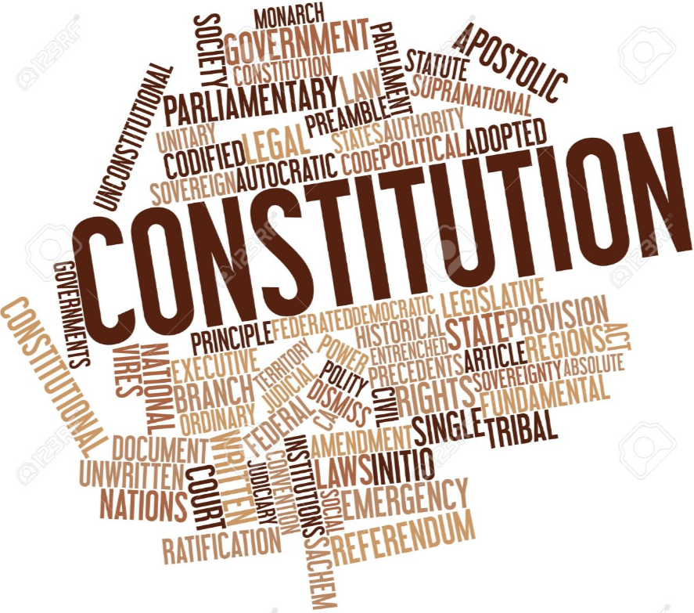
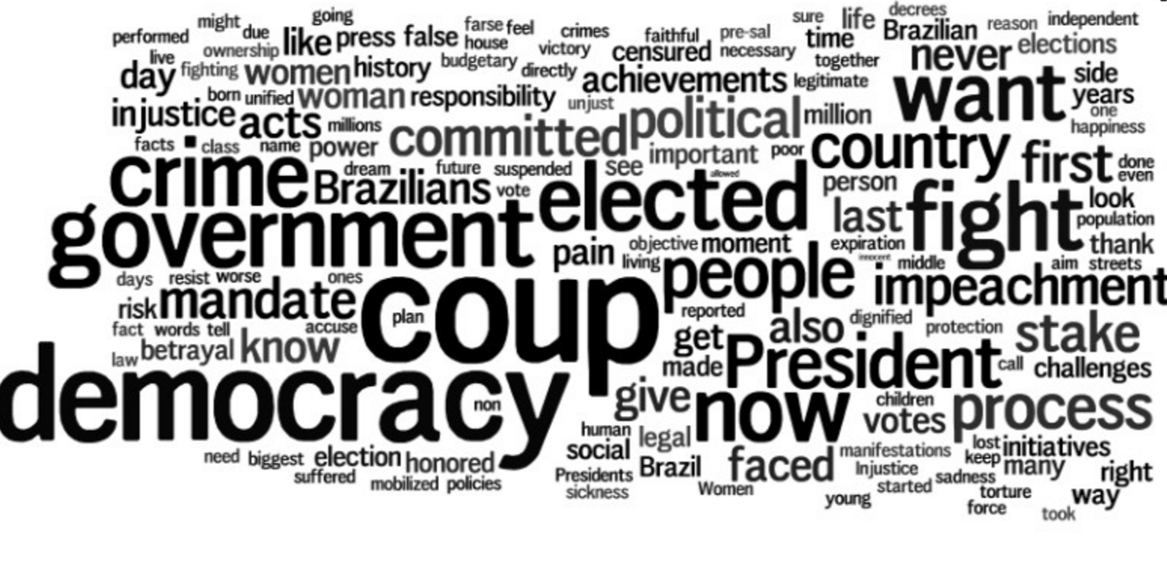
LESSON 2: PLENARY
step 1: WORD CLOUD IN TAGUL WITH THE NEW KEYWORDS
Together with the class the teacher builds a word cloud with the new keywords

Slide 12
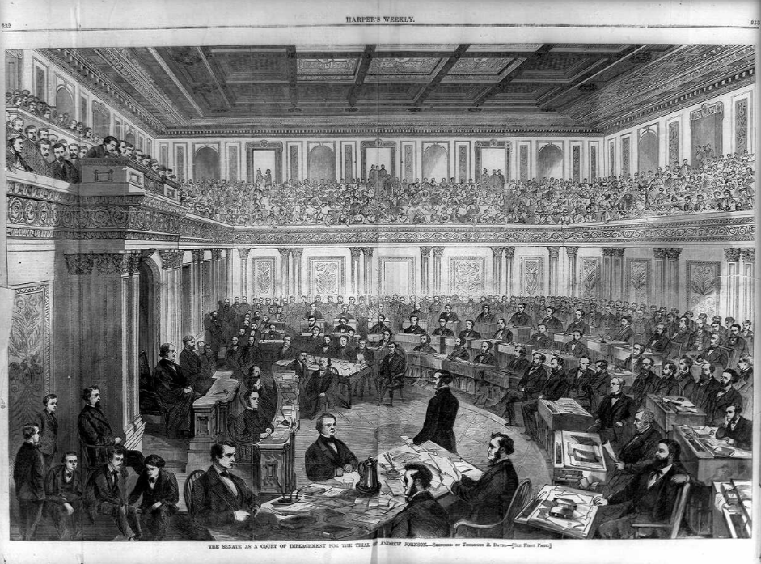
step 2: FRONTAL LESSON
WHAT IS IMPEACHMENT?
A process that is used to charge, try, and remove public officials for misconduct while in office.
The reluctance of lawmakers to use this power is a measure of its gravity.
It is generally only invoked by evidence of criminality or substantial abuse of power.

Slide 13
HISTORICAL BACKGROUND: Crash course of history of impeachment of head of state
HOUSE OF COMMONS AND HOUSE OF LORDS
…………………………………..
600 BC
1300
1776
NOW-A-DAYS
ANCIENT ATHENS
BOULE’
THE CONSTITUTIONAL CONVENTION INCLUDED MUCH OF COMMON LAW

Slide 14
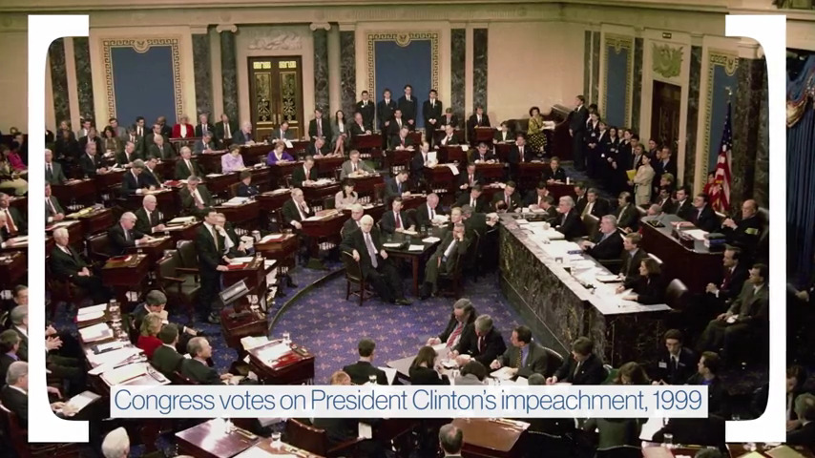
step 3: HOW DO YOU IMPEACH A PRESIDENT IN THE USA? (YouTube Video + script)
https://www.youtube.com/watch?v=NRwPqfPFHSw
In 1999 The impeachment trial of President Bill Clinton began.
Impeachment is the result of the impeachment process, started by the House of Rapresentatives, It is the removal of the President from office if the trial in front of the Senate finds him guilty
The American Constitution lists these violations: «Treason, Bribery, and other High Crimes and Misdemeanors»

Slide 15
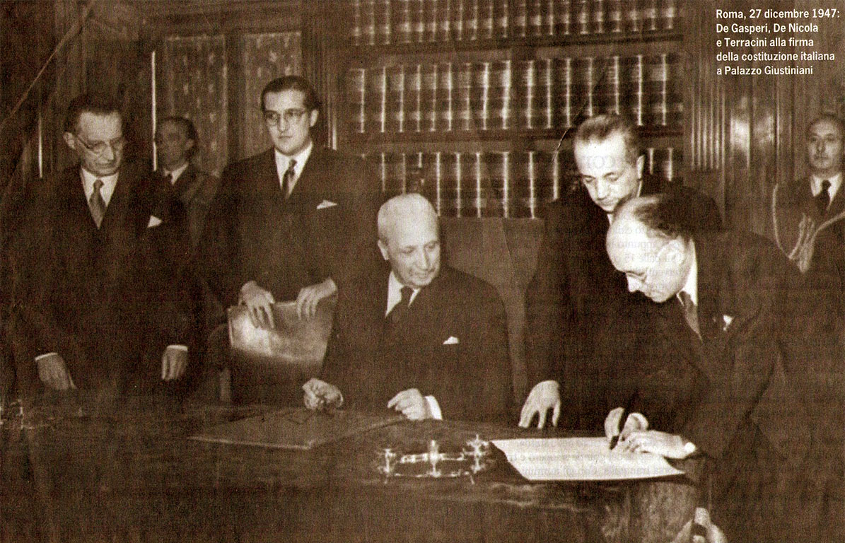
step 4: THE IMPEACHMENT IN THE ITALIAN CONSTITUTION
^{ART. 90}
The President of the Republic is not responsible for the actions performed in the exercise of the presidential duties, except in the case of high treason or attempt against the Constitution.
In such cases, the President may be impeached by Parliament in joint session, with an absolute majority of its members.

Slide 16
LESSON 3: GROUP WORK
step 1: HOW TO FIND INFORMATION ABOUT IMPEACHMENT IN EUROPEAN CONSTITUTIONS?
Teacher divides the class in 4 groups of 4 students, assigns an European constitution and invites the groups to visit the website and learn how to use it
https://www.constituteproject.org/
The learners look for information of the President Impeachment of these States
ITALY, FRANCE, GERMANY, PORTUGAL, FINLAND and IRELAND

Slide 17
step 2: COMPLETE THE TABLE
The students compare the Italian Constitution with the assigned one about impeachment and complete the following table to present to the class at the end of the searching activity
COUNTRY NAME – FLAG – BORDERS – EUROPEAN CAPITAL – FORM OF STATE – FORM OF GOVERMENT
IMPEACHEAD PRESIDENT
TYPES OF PRESIDENTIAL VIOLATIONS
PROCEEDINGS - ARTICLES
COMPETENT OFFICE TO IMPEACH
COMPETENT OFFICE TO JUDGE THE PRESIDENT
……….

Slide 18
SAMPLE OF COMPLETE CHART

Slide 19
step 3: COMPLETE THE VOCABULARY WITH THE NEW KEYWORDS

Slide 20
LESSON 4: PRESENTATION TO THE CLASS, REVISION AND ASSESSMENT
step 1: EACH GROUP LEADER DESCRIBES THE TABLE IN THE ICT LAB (15’ per group)
step 2: TEACHER SUGGESTS TO LOOK FOR NEWS ABOUT IMPEACHED PRESIDENT OF THE EXAMINED COUNTRIES
step 3: IS IT EASY TO IMPEACH A PRESIDENT? WHY?

Slide 21
REVISION, ASSESSMENT AND EVALUATION
step 1: TEST
QUESTION | ANSWER
What kind of crimes impeaches a President? | ……………………………………………………………………………………………………………………………………………………………..
What is the competent office to impeach and to judge a President? | ……………………………………………………………………………………………………………………………………………………………..
What are the effects of the Head of State impeachment and conviction? | ……………………………………………………………………………………………………………………………………………………………..

Slide 22
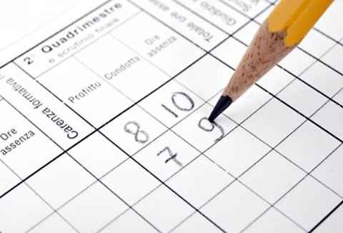
step 2: ASSESSMENT AND EVALUATION
EVALUATION
FORMATIVE ASSESSMENT in language and content
SUMMATIVE ASSESSMENT in language and content
Exercise of Q/A
Homework of dictionary
Observation of the student in their group and during the lesson
Grade 10: high quality of work performed
Grade 8-9 : performance exceeded expecations in all the skills
Grade 6-7: the work overall is sufficient, error is acceptable
Grade 4-5: some uncompleted exercise, needs to develop analytical skills
Grade 2-3: has made frequent errors in L2 and about the topic
Test of Q/A

Slide 23
THANK YOU
[5]

Slide 24
References - Webliografy
[1] Il Sole 24Ore, 16 gennaio 2014
[2] Il Corriere della sera 28 gennaio 2014
La Costituzione italiana
Le Carte Costituzionali di paesi europei
https://www.ucl.ac.uk/constitution-unit/whatis/uk-constitution
http://comparativeconstitutionsproject.org/other-resources/
https://www.cia.gov/library/publications/the-world-factbook/geos/it.html
confronto tra costituzioni: https://www.constituteproject.org/search?lang=en&c
commento art. 68 Costituzione francese relativo alla responsabilità del PDR: http://www.giurcost.org/studi/giovannetti.htm
articolo da reuters http://www.reuters.com/article/us-italy-politics-idUSBREA1A0VH20140211
http://www.dictionaryofeconomics.com/dictionary
http://europa.eu/teachers-corner/home_en
Definizione del termine impeachment: http://legal-dictionary.thefreedictionary.com/impeachment
Sito ufficiale del presidente della repubblica italiana: http://www.quirinale.it/elementi/Elenchi.aspx?tipo=Video
Impeachment in Usa : http://www.infoplease.com/spot/impeach.html

