Slide 1

Friendship
What’s friendship?
How to keep friendship?

Slide 2
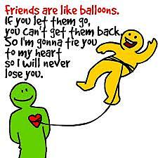


Slide 3
What is friendship ?
Friendship is an in-depth relationship. Friendship is
comfortable end peaceful. Friendship requires meeting
the needs of both friends.
«Sometimes you meet a person and you just click- you’re comfortable with them, and you don’t have to pretend to be anyone or anything.»

Slide 4

Building a friendship from a casual friends
Building friendship takes time.
Friendships need self-disclosure so
any friendship can present risks.
Talking and listening develops friendship

Slide 5
Preservation of friendship
One-to-one contact is a prerequisite of friendships. Conflict must be resolved
for friendships to continue.
Friendships do end.
Friendships may not last. The worst enemy of friendships is change by one or both friends.

Slide 6

Setting limits in friendships
You set limits with your friends because you care for them and your relationship with them, not because you don’t.
Conversation
Being able to carry on a comfortable conversation in a social relationship is a matter of practice and following certain procedures in communicating.
Friendship ‘s symbol

Slide 7
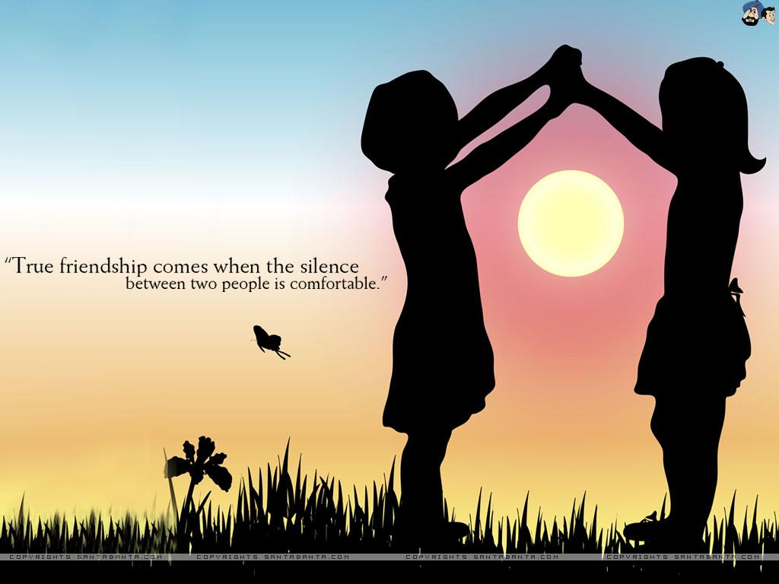

Slide 8

How
To
keep
friendship
?

Slide 9
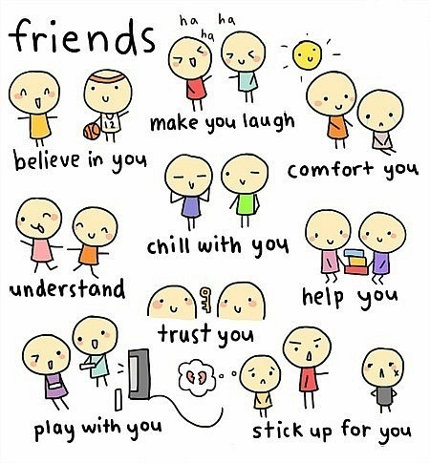

Slide 10
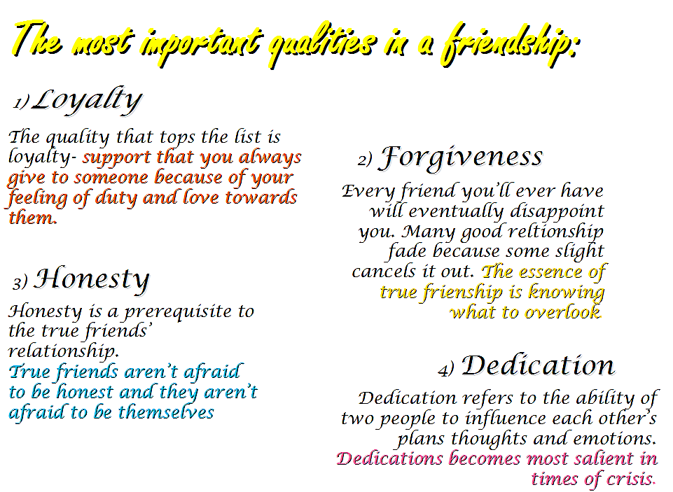

Slide 12

Another red letter day
So the pound has dropped and the children are creating
The other half ran away
Taking all the cash and leaving you with the lumber
Got a pain in the chest
Doctor's on strike what you need is a rest
It's not easy love
but you've got friends you can trust
Friends will be friends
When you're in need of love
T hey give you care and attention
Friends will be friends
When you're through with life and all hope is lost
Hold out your hands cos friends will be friends right till the end
Now it's a beautiful day
The postman delivered a letter from your lover
Only a phone call away
You tried to track him down but somebody stole his number
As a matter of fact
You're getting used to life without him in your way

Slide 13

It's so easy love cos you got friends you can trust
Friends will be friends
When you're in need of love they give you care and attention
Friends will be friends
When you're through with life and all hope is lost
Hold out your hands cos friends will be friends right till the end
It's so easy love cos you got friends you can trust
Friends will be friends
When you're in need of love they give you care and attention
Friends will be friends
When you're through with life and all hope is lost
Hold out your hands cos friends will be friends right till the end
Friends will be friends
When you're in need of love they give you care and attention
Friends will be friends
When you're through with life and all hope is lost
Hold out your hands cos right till the end

Slide 15
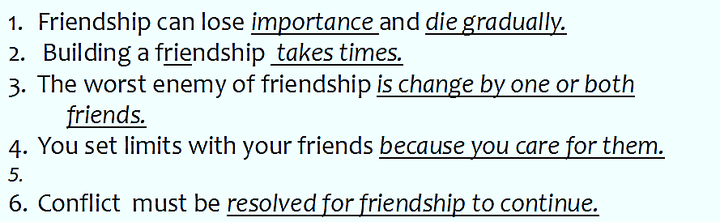
Checking
Comprehension

Slide 16
Literature
Harry potter is a series of seven fantasy novels, about a boy named Harry Potter who grows up with normal people.
When he gets a letter from Hogwarts Harry discovers he is wizard. At Hogwarts he learns to use magic and to beat many magical and emotional obstacles.
His enemy is Voldemort. Harry challenges the Dark Lord for the last time, and only will be the only survivor.

Slide 18
Created
by
…
Maiorani Concetta
Fabiani Francesca
Angelini Fabiola
Rubini Ilaria
Di Sabatini Francesca
Tarquini Luca

